Slide 1
Making Salads Great Again
Team 6
Ernest Ang Cheng Han - U1921310H
Jalvin Nai Guang Jun - U1810925F
Jordan Low Cheng Lin - U2010804E
Liu Qingyi - U1921143C
Cao Thuc Anh (Adeline) - U2010720G

Slide 2
TABLE OF CONTENTS
01
02
03
04
05
Problem 1: Selection of Salad Ingredients
Solution 1: Salad Linear Optimiser
Problem 2: Order Quantity Optimisation
Solution 2: Order Quantity Stochastic Model
Evaluation & Conclusion

Slide 3
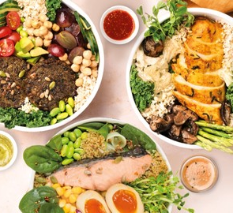
SALADSTOP
First and largest healthy food chain in Asia
Full access to the nutritional facts, serving portions and carbon footprint information
Create Your Own Salad Menu contains a selection of:
4 different greens bases
4 wraps
2 grain bowls
57 toppings
19 dressings

Slide 4
PROBLEM 1: SELECTION OF SALAD INGREDIENTS
Customer Pain Points
Too much choices are given to their customers
Computationally hard to come up with an order that truly matches their needs → given access to nutritional information by Salad Stop
Short time frame of queuing and ordering
Large number of 87 ingredients to pick from
Customers face difficulty making the most optimum choice based on their own requirements
Some customers will also have specific dietary and allergy requirements to consider

Slide 5
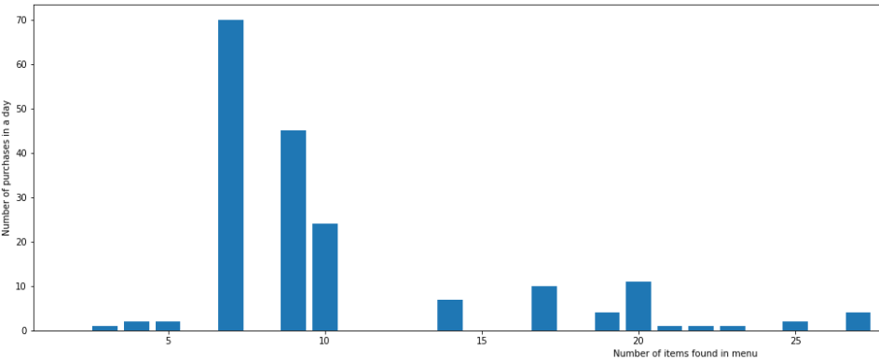
PURCHASES BY #MENU OPTIONS
The optimal number of items on menu that receives highest number of purchases seem to be 7 items.
Notes:
We will then look into a dataset to find the relationship between the number of choices and how it influences the purchase probability of a consumer. From the following graph, we observe that restaurants with low number of items on their menu encounter lower number of purchases. On the other end of the extreme, restaurants with high number of items of their
menu encounter also encounter low number of purchases. The optimal number of items on menu that receives
highest number of purchases seem to be 7 items.

Slide 6
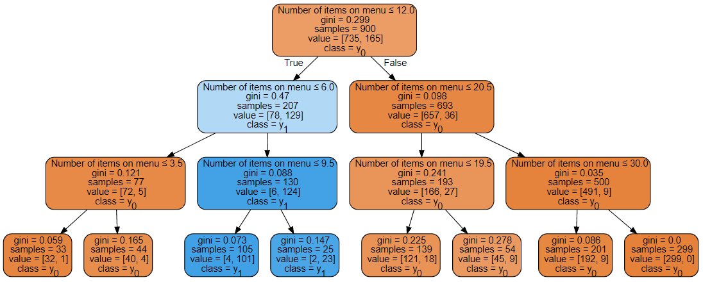

PURCHASES BY #MENU OPTIONS
Probability of purchase is the highest when:
6 <= # menu options <= 12
Notes:
In this section, We will build a model based off our artificially generated dataset to be able to predict the purchase probability based on number of options given to consumers.

Slide 7
SOLUTION 1: SALAD LINEAR OPTIMIZER
Satisfy customer needs
Provide fewer menu options
Selected ingredients for the salad will meet customer’s unique diet and nutritional needs
Within customer’s budget limit
Consider other dietary requirements
Select the ingredients and come up with a few salad menu options
Customers will not have to pick from all 87 ingredients
Increase purchase probability and sales
Notes:
Linear optimisation model is used to help customers create lesser menu options by suggesting salad menu options instead of allowing customer to pick from 87 ingredients

Slide 8
LINEAR OPTIMIZER FOR SELECTION OF SALAD INGREDIENTS
Data:
We recorded the 87 ingredients from SaladStop!’s Create your Own web page.
2 standard bases
2 premium bases
4 wrap options
2 grain bowl options
34 standard toppings
24 premium toppings
19 types of salad dressings.
For each of the ingredients, we stored nutritional information such as:
Serving size
Calories
Carbohydrates
Protein
Fat
Sugar
We also noted if ingredients were:
Vegan
Vegetarian
Gluten-free
Containing nuts
Containing dairy
Spicy
Notes:
A list of 87 ingredients we recorded from SaladStop’s create your own webpage. This includes 2 standard bases, 2 premium bases, 4 wrap options, 2 grain bowl options, 34 standard toppings, 24 premium toppings and 19 types of salad dressings. For each of these ingredients, we have their nutritional information (per serving), such as its serving size, calories, carbohydrates, protein, fat, sugar, whether it is suitable for vegans and vegetarians, if it is gluten-free, if it contains nuts and dairy and if it is spicy.

Slide 9
LINEAR OPTIMIZER FOR SELECTION OF SALAD INGREDIENTS
Model Objective:
To minimize cost paid by customer while meeting the customers’ input constraints.
Aid customers in the presence of too many choices
Variables:
Variable X - a binary variable to decide if the ingredient is to be included in the salad.
Variable S - a binary variable to decide if a salad should contain a standard salad base.
Variable T - a binary variable to decide if a salad should contain a premium salad base.
Notes:
Binary variable to decide if we should select an ingredient to be included in the salad.
Binary variable to decide if a standard salad base is more suitable for the customer’s needs.
Binary variable to decide if a premium salad base is more suitable for the customer’s needs.

Slide 10
LINEAR OPTIMIZER FOR SELECTION OF SALAD INGREDIENTS
User inputs:
Nutritional preferences - Minimum and maximum of:
Calories
Carbohydrates
Proteins
Fat
Sugar
Cost-related preferences:
Budget
Minimum amount of premium toppings
Dietary preferences:
Vegan
Vegetarian
Gluten-free
Nuts
Dairy
Spice
Notes:
To understand the needs of the customer’s salad, we get the customers’ dietary and nutritional preferences. These include the minimum and maximum amount of calories, carbohydrates, proteins, fat and sugar the customer is willing to accept in the salad.
We also get information on whether the customer requires vegan, vegetarian, gluten-free options and if the customer is allergic to nuts, dairy and spice. We also get information about the customer’s budget for this salad as well as if there is any minimum amount of premium toppings that the customer wants in the salad.

Slide 11
LINEAR OPTIMIZER FOR SELECTION OF SALAD INGREDIENTS
Constraints:
Ingredients with 0 quantity left will not be selected
Optimizer will select ingredients of the same category as the type of base selected.
Exactly 1 of either a standard or premium base is selected.
Exactly 7 toppings will be selected unless the user elects to have more.
Only 2 salad dressings will be included in the salad unless the user elects to have more.
The selection of the ingredients meets the nutritional requirements of the customer.
The selection of the ingredients meets the dietary requirements of the customer.
The number of premium toppings selected meet the requirements of the customer.
The total cost of the salad is within the customer’s budget.
Notes:
Constraint 1: Optimizer will not select ingredients with 0 quantity left.
Constraint 2: Ingredients should be of the same category as the type of base selected.
Constraint 3: Ensure that exactly 1 of either a standard or premium base is selected.
Constraint 4: Ensures that exactly 7 toppings unless the user elects to have more.
Constraint 5: Ensure that only 2 salad dressings will be included in the salad unless customer elects to have more.
Constraint 6: Ensure that the selection of ingredients meets the nutritional requirements of the customer.
Constraint 7: Ensure that the selection of ingredients meets the dietary requirements of the customer.
Constraint 8: Ensure that the number of premium toppings meet the customer’s requirement.
Constraint 9: ENsure that the total cost of the salad is within the user’s budget.

Slide 12
Linear Model:
Live Demo

Slide 13
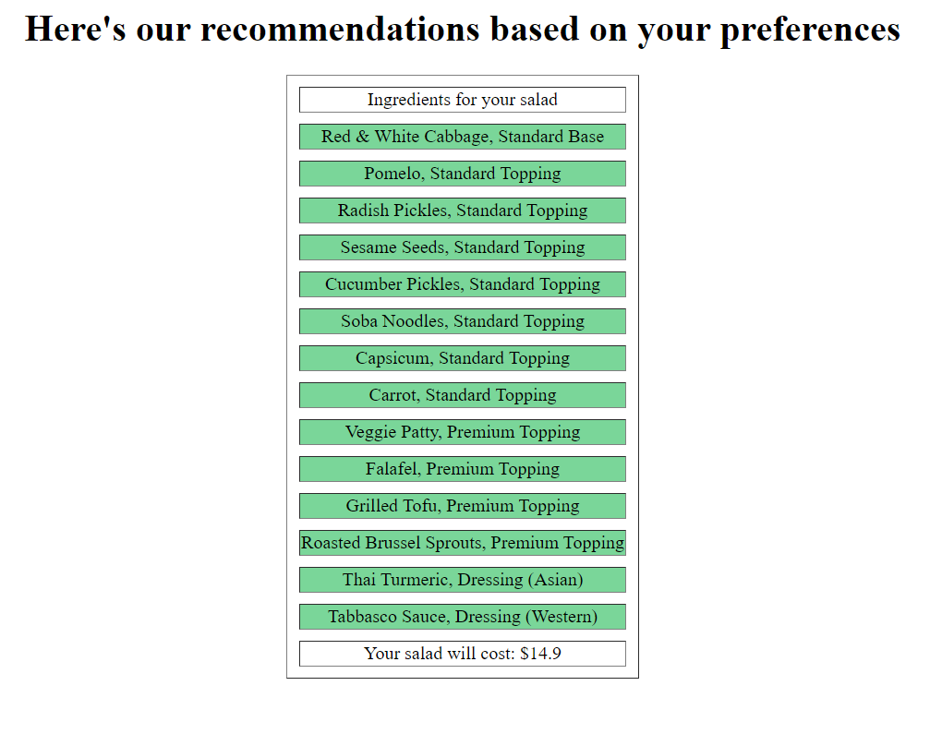
Other results
Person A’s inputs:
Nutritional preferences:
Calories (kcals) [200, 600]
Carbohydrates (g) [20, 120]
Proteins (g) [10, 80]
Fat (g) [5, 35]
Sugars (mg) [10, 50]
Dietary preferences:
Not vegan
Not vegetarian
Non Gluten-free
Nuts
No Dairy
Can take spice
Cost-related:
Minimum premium ingredients = 4
Budget = $15
Notes:
Calories: 200 - 600
Carbohydrates: 20 - 120
Proteins: 10 - 80
Fats: 5 - 35
Sugars: 10 - 50
Min premium ingredients = 4
Budget = $15
Not vegan
Not vegetarian
Non gluten-free
No dairy
Not allergic to nuts
Can take spice

Slide 14
Notes:
Calories: 200 - 600
Carbohydrates: 20 - 120
Proteins: 10 - 80
Fats: 5 - 35
Sugars: 10 - 50
Min premium ingredients = 4
Budget = $15
Not vegan
Not vegetarian
Non gluten-free
No dairy
Not allergic to nuts
Can take spice

Slide 15
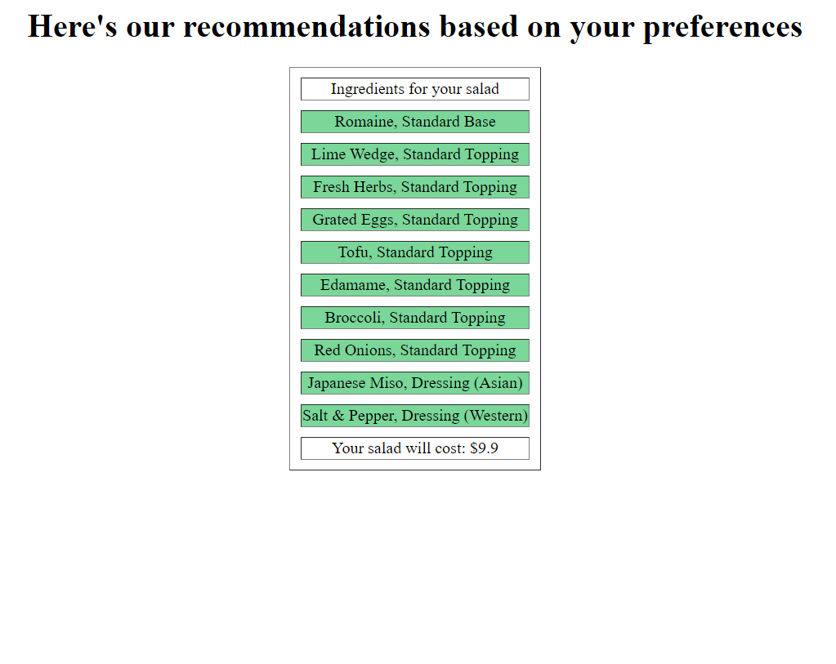
Other results
45%
Person B’s inputs:
Nutritional preferences:
Calories (kcals) [100, 500]
Carbohydrates (g) [0, 20]
Proteins (g) [0, 90]
Fat (g) [0, 20]
Sugars (mg) [0, 200]
Dietary preferences:
Not vegan
Not vegetarian
Gluten-free
Nuts
Dairy
Can take spice
Cost-related:
Minimum premium ingredients = 0
Budget = $18
Notes:
Calories: 100 - 500
Carbohydrates: 0 - 20
Proteins: 0 - 90
Fats: 0 - 20
Sugars: 0 - 200
Min premium ingredients = 0
Budget = $18
Not vegan
Not vegetarian
Gluten-free
Not allergic to dairy
Not allergic to nuts
Can take spice

Slide 16
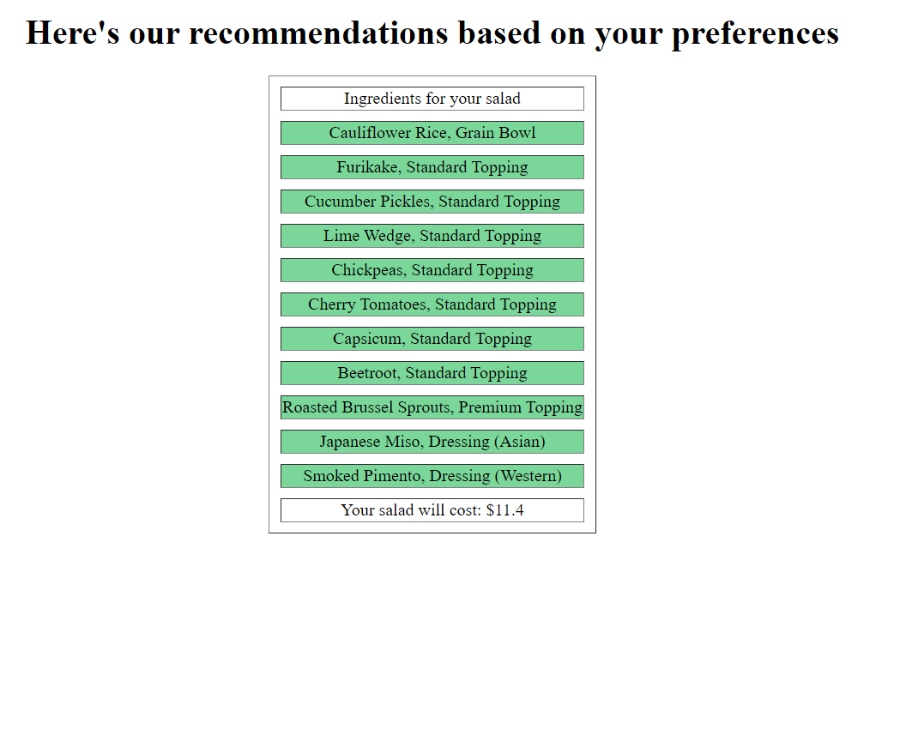
Other results
45%
Person C’s inputs:
Nutritional preferences:
Calories (kcals) [100, 250]
Carbohydrates (g) [10, 40]
Proteins (g) [10, 30]
Fat (g) [0, 10]
Sugars (mg) [0, 60]
Dietary preferences:
Vegan
Not vegetarian
Gluten-free
Nuts
Dairy
Cannot take spice
Cost-related:
Minimum premium ingredients = 1
Budget = $15
Notes:
Calories: 100 - 250
Carbohydrates: 10 - 40
Proteins: 10 - 30
Fats: 0 - 10
Sugars: 0 - 60
Min premium ingredients = 1
Budget = $15
Vegan
Not vegetarian
Gluten-free
Not allergic to dairy
Not allergic to nuts
Cannot take spice

Slide 17
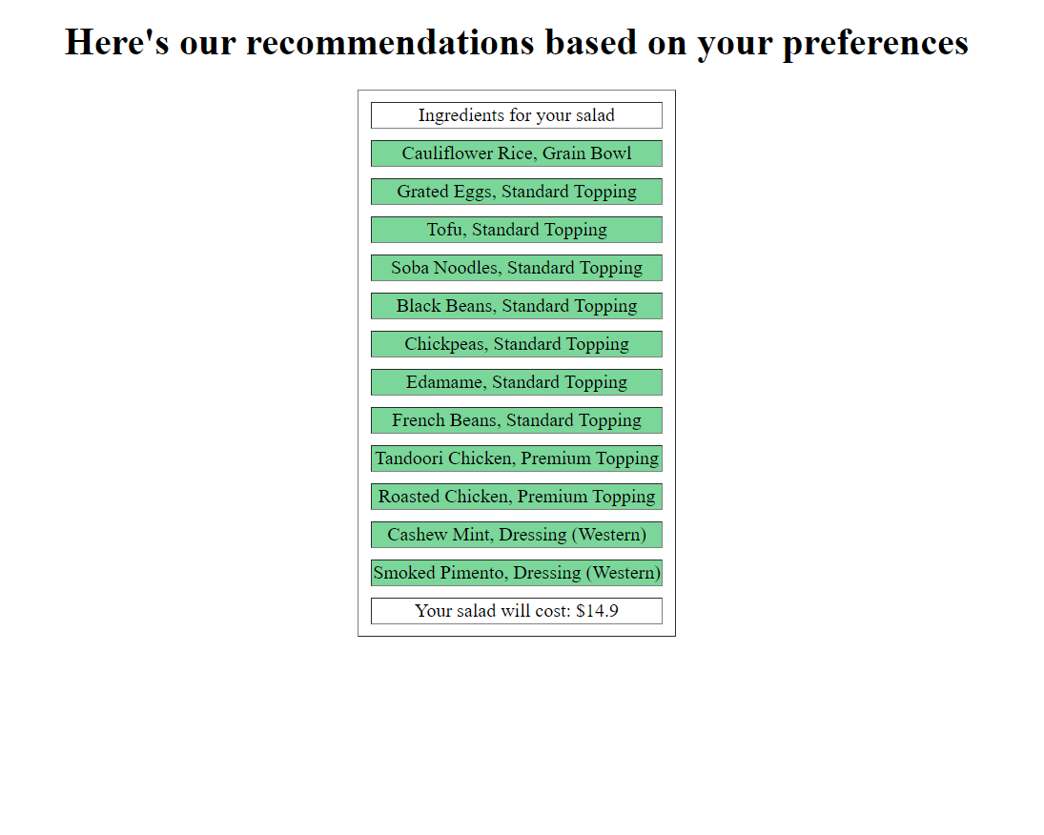
Other results
45%
Person D’s inputs:
Nutritional preferences:
Calories (kcals) [200, 700]
Carbohydrates (g) [20, 250]
Proteins (g) [60, 250]
Fat (g) [10, 50]
Sugars (mg) [0, 200]
Dietary preferences:
Not vegan
Not vegetarian
Non Gluten-free
No Nuts
No Dairy
Cannot take spice
Cost-related:
Minimum premium ingredients = 2
Budget = $30
Notes:
Calories: 200 - 700
Carbohydrates: 20 - 250
Proteins: 60 - 250
Fats: 10 - 50
Sugars: 0 - 200
Min premium ingredients = 2
Budget = $30
Not vegan
Not vegetarian
No need Gluten-free
No dairy
No nuts
Cannot take spice

Slide 18
HOW THE LINEAR OPTIMIZATION MODEL HELPS SALAD STOP
CUSTOMER-SIDE
BUSINESS-SIDE
Optimize the buying process for customers by fitting their preferences and requirements.
SaladStop! can expect higher customer satisfaction.
Improve customer conversion rate as salad sales are more likely when customers are not overwhelmed by choices.
The increase in demand for salad then provides another opportunity for optimization - ingredient orders.

Slide 19
ORDERED QUANTITY OPTIMISATION
Using stochastic optimisation to optimise quantities of ingredients to order

Slide 20
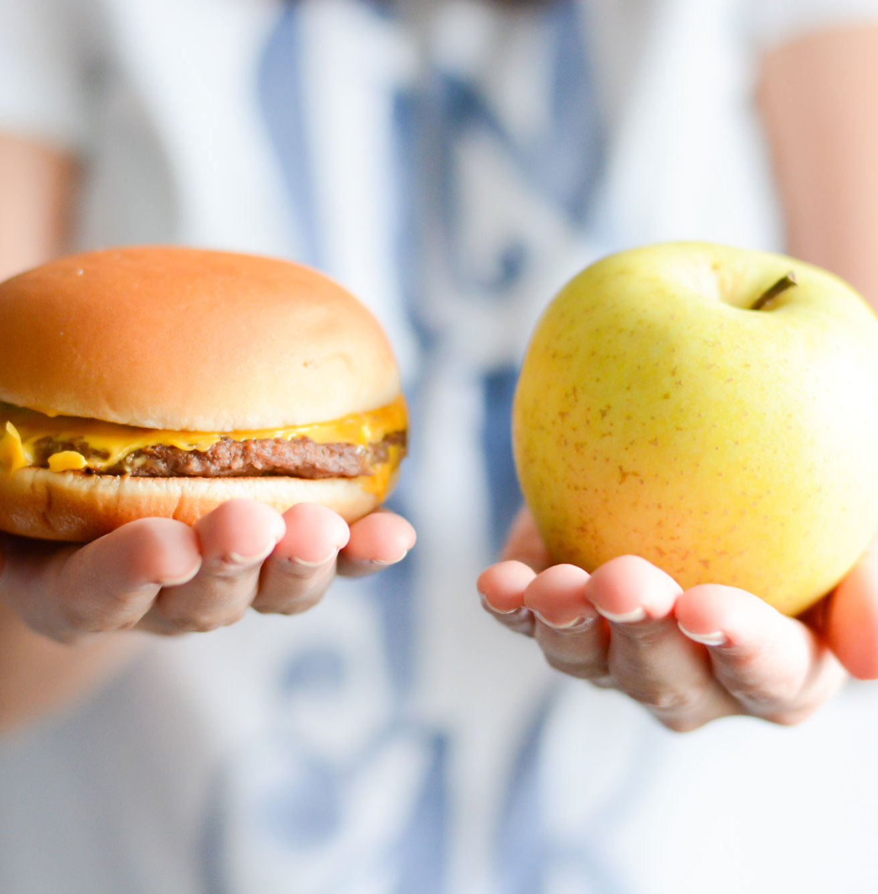

Motivations - Changes in demand
Population tastes & preferences
Cost-efficient ingredients

Slide 21

Solution - Machine Learning + Stochastic Optimisation
We will first use machine learning in order to predict the amount of ingredients used in the future
If we can forecasted demand of ingredients, Salad Stop will know roughly how much ingredients to order in the following month

Slide 22
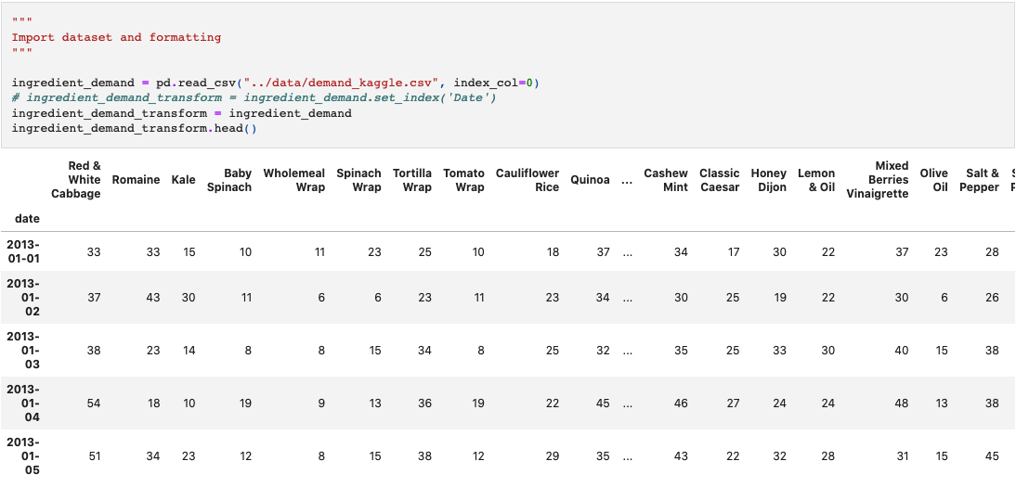
Dataset
45%

Slide 23
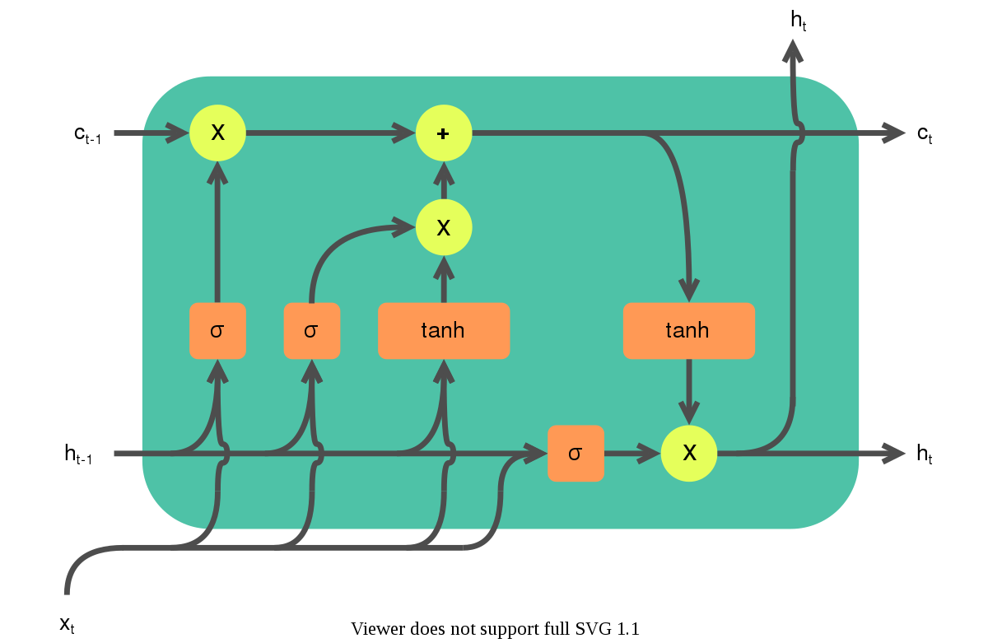
Model Generation
Long Short Term Memory (LSTM) Neural Network

Slide 24

Model Limitation
Using the results from our LSTM model is insufficient given that it does not account for external factors such as the issue of space.
We will further need to optimise the results using a Stochastic Model, based on the multi-item newsvendor problem

Slide 25
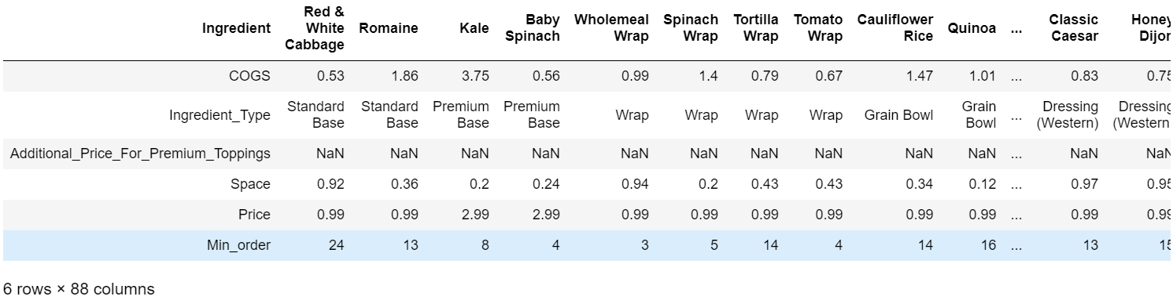
Stochastic model: Input

Slide 26
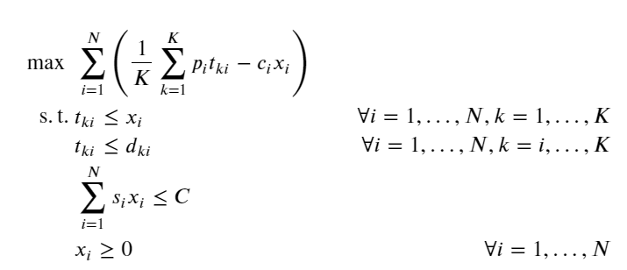
Stochastic model: Implementation
No. of types of ingredients
No. of past demands
Cost of each ingredient
Order quantity
Space occupied by unit of each ingredient
Selling price of each ingredient
Sale quantity, i.e. minimum of order quantity & demand
Replaced by min_order
Total available space

Slide 27
Stochastic Model:
Model Explanation

Slide 28
05
Evaluation
Evaluation and conclusion of both optimisers

Slide 29
Salad Choices
Normal Order
Optimised order
More control over ingredients/ taste
Computationally hard to manually calculate calories and macronutrients
More control over macronutrients and calories
No accidental inclusion of disliked preferences (Spicy, Vegan, Vegetarian)
Lowered costs for Salad Stop
Less control over ingredients/ taste

Slide 30
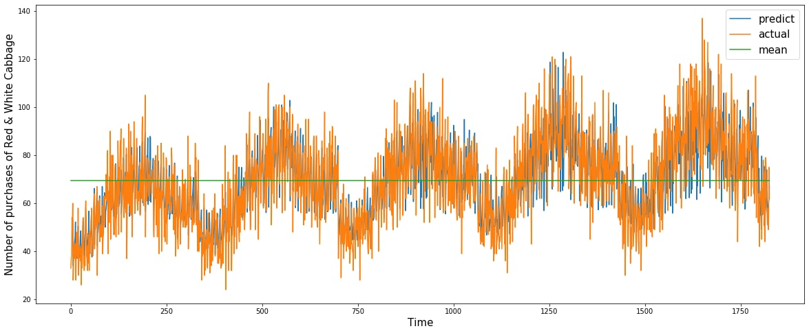
Quantity to Order
VS
Highly Accurate Prediction through the use of Neural Networks
Use of mean to repeatedly order the same amount every

Slide 31
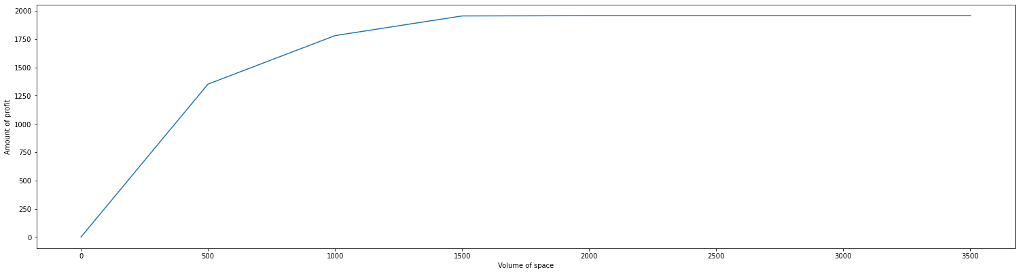
Quantity to Order
From this plot we have also observed that profit plateaus once Space > 1500
Marginal Benefit once Space of store >1500
Ideal storage space of store should be at 1500 units

Slide 32
Areas Of Improvement/ Expansion
Use of Better Data
Constraints in model
Applicability of Models
Sensitivity Analysis
Use of derived demand data
Inaccuracies in the COGS
Inclusion of Carbon footprint of salad & Ingredients
Salad Optimizer and Stock Optimizer can be used on other businesses directly; Subway, Wok/Pasta Express, Maki Sushi
Potential use after modifications in other businesses to help lower costs and solve their own multiple newsvendor problem
Finding shadow price of Salad Ingredients
Inclusion of price differentiation based off customers’ order

Slide 33
THANK YOU

